Slide 1

Video Surveillance System
Proposal and Feasibility Presentation Template
Nabeel Saleem CIIT/FA20-BSE-122/ATD
Hammad Ur Rehman CIIT/FA20-BSE-126/ATD
Zain Asif CIIT/FA20-BSE-136/ATD
Supervisor-name:
Dr. Saad Mustafa
Department of Computer Science
COMSATS University Islamabad, Abbottabad Campus

Slide 2
Agenda of the Presentation
Motivation
Brief Introduction
Scope
Functionalities
Proposal Tools Platform
Feasibility
Technical Feasibility
Financial Feasibility
Resource Feasibility
Operational Feasibility
Schedule
Take for First Iteration
Conclusion

Slide 3
Motivation & Utility
The increasing crime rates in Pakistan
No Real-time Violence Detection
Expensive Monitoring Cost
Improve Public Safety
Improve Businesses Security
Help Law Informant Agencies

Slide 4
Brief Introduction
The proposal underscores the critical need to address rising crime rates in Pakistan by implementing a real-time violence detection system. This intelligent software solution aims to enhance security, reduce costs, and save lives by rapidly identifying and responding.

Slide 5
Scope
The proposed project Video Surveillance System will be an android based application.
Admin will login securely
The admin will create users.
Only registered users will see the abnormal activities in application.
System provides violence evidence to register users.
The system will allow upload video for violence detection.
System should only detect violent activities.
System will only detect violence activities when camera working properly

Slide 6
Our Scope will not include:
System will not detect violence in dark.
System will not detect every abnormal activities in the environment.
Delay can occur due to high throughput.
Our System could not deal with Audio Violence.
Performance may vary based on the quality and positioning of camera.
Changes in weather conditions or cluttered backgrounds may affect the accuracy of system.
Our System will only record abnormal activity clip.

Slide 7
Functionalities
FR01-Admin will be able to sign up and login using their credentials.
FR02-Admin will create users accounts.
FR03-Admin will remove users accounts.
FR04-Admin will update their credential

Slide 8
Functionalities
FR05-System will be allow the user to login to system using username and password provided by admin.
FR06-User will upload video from gallery
FR07-System will detect violence activity.
FR08-User will see the violence clip from uploaded video.
FR09-System will provide violence notification.
FR10-User will see violence activity notification.

Slide 9
Proposed Tools/Platform
Tools And Technologies | Tools | Version | Rationale
 | Android Studio | 2022 | IDE
 | Flutter SDK | 2023 | UI toolkit
 | Firebase |  | Realtime DBMS
 | Star UML | 3.2.2 | System Modeling
 | MS Word | 2022 | Documentation
 | MS Power Point | 2022 | Presentation
 | Figma | 2.0.5 | Mockups Creation
 | Technology | Version | Rationale
 | Dart | 6.0 | Programming language
 | Django | 4.2.5 | Backend Development
 | Flutter | 3.10 | Mobile Application Development
 | UML | 2023 | Modeling Language

Slide 10
Feasibility
Technical feasibility
Dart
Python
Firebase
Figma /Adobe XD
GitHub
Draw.IO
Pycharm / Jupyter Notebook

Slide 11
Feasibility
Financial feasibility
Technology/Tools | Cost | Acquired
Dart | Free(open Source) | Internet
Firebase | Limited Resources | Internet
Internet | Market price | Broadband Connection
Figma | Free | Internet
laptop | Market Price | Funds
GPU | Market Price | Funds
camera | Market Price | Funds

Slide 12
Feasibility
Resource feasibility
Firebase
Camera for Detection
Smart Phone application development Tools

Slide 13
Feasibility
Operational feasibility
User friendly interface
No need for instruction manual
Easy modifiable
Stable internet connection required

Slide 14
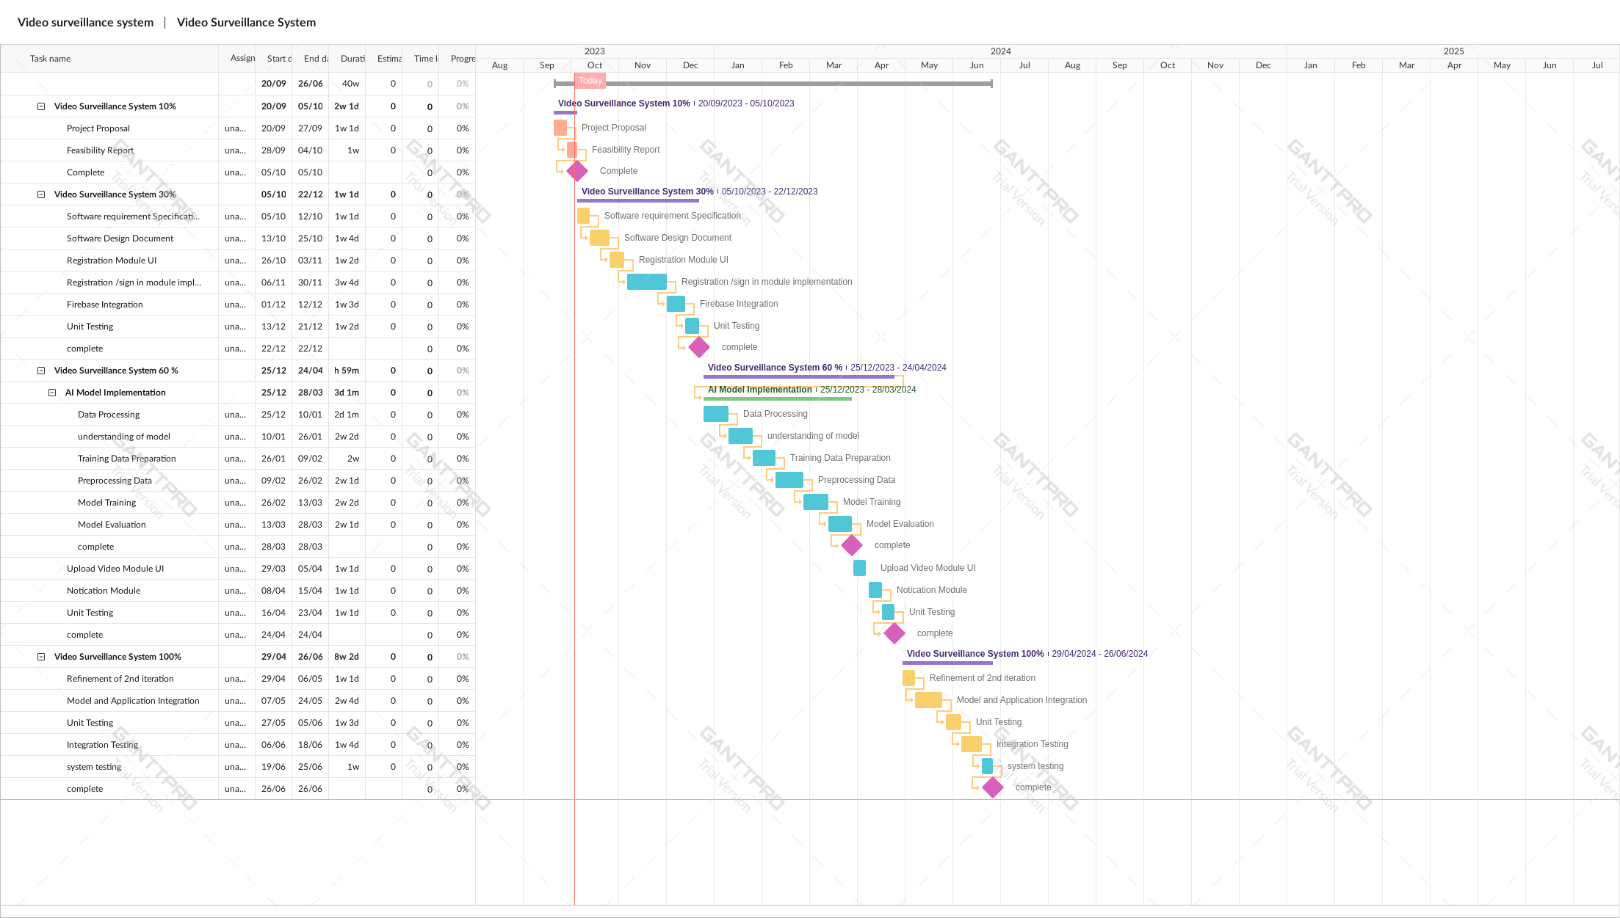
Schedule

Slide 15
Tasks for 1st Iteration (or 30%)
The task for 30% percent iterations are as under :
Software Requirement Specification
Software Design Description .
Registration Module UI
Registration / Sign in Module for admin and user
Unit Testing

Slide 16
Conclusion
A video surveillance system is a critical system for enhancing security and ensuring public safety. Detection of violence in uploading videos.This proactive approach not only determines the abnormal behavior but also provides valuable evidence for investigations. A well-implemented surveillance system, when integrated with appropriate user, can contribute significantly to creating safer communities.

